Slide 1
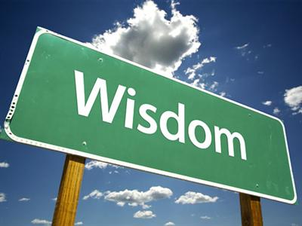
How do we learn to be wise?
This Photo by Unknown Author is licensed under CC BY-SA-NC

Slide 2
WISDOM IN THE PROVERBS
Wisdom is the principal thing
Proverbs 4:7
What does God mean when he says wisdom is like a house filled with treasure?
Prov 24:3, 4
Wisdom knows when to speak and not to speak Prov 17:27, 28 and Prov 18:21
Wisdom understands the value of self control Prov 11:29, 25:27-29
Wisdom seeks counsel from others
Prov 15:21-23
Wisdom takes advantage of life experiences Prov 18:20
Life experiences and wisdom are paired together

Slide 3
1. Government Leaders 2. Church Leaders 3. Medical Authorities 4. Families in Lockdown
Proverbs 2
How is God’s wisdom different from worldly wisdom?
Wisdom is related to the heart as well as the mind
Why is wisdom compared to a treasure?

